Slide 1
NEXTHIKES IT SOLUTIONS:- Feature Extraction and Price Prediction for Mobile Phones
NAMAN sHARMA

Slide 2
AGENDA
PROJECT OVERVIEW
DATA ANALYSIS
VISUALIZATIONS
FEATURE ENGINEERING
MODEL BUILDING
MODEL COMPARISON
MOBILE PRICE PREDICTION MODEL
Feature Importance

Slide 3
PROJECT OVERVIEW
The primary goal is to develop a predictive model for mobile phone prices.
The analysis covers key tasks such as data preprocessing, missing value handling, feature engineering, correlation analysis, outlier detection, and model evaluation.
The goal is to predict mobile prices using various factors such as RAM, Memory, Front Camera, Rear Camera and overall quality.

Slide 4
Data ANALYSIS
Dataset Overview Data Exploration
Total Entries: 541 No Columns has missing value.
Total Features: 12
Data Types: Unnamed: 0 :- Dropped due to
Numerical Features: 5 unused column.
Categorical Features: 6
Target Variable: Price
Key Objective: Predict mobile prices based on various features.

Slide 5
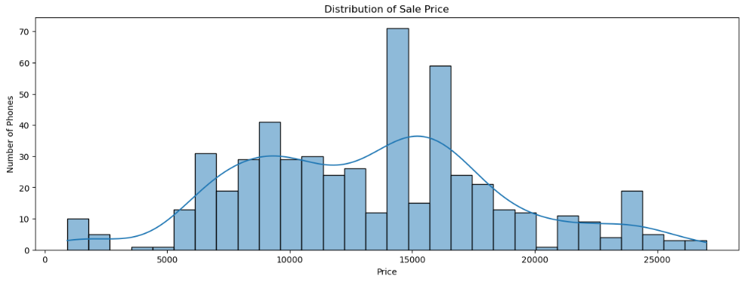
DISTRIBUTION OF SALE PRICE
1. We can see its a positively skewed data as the skewness > 0. and tail of dataset is on the right side.
2. The majority of the phones we sold between the range of 9000 to 17000. (Tells that the demand of mid-range phones are high).
3. As the price increases the sale started to decrease i.e. phones above the range of 20000 were less sold in numbers. (Tells that the premium range phones are sold less frequently).
4. Also the phones below the range of 9000 were less sold.
5. Few exceptions can also be seen such as phones of 21000 and 4000 are the least sold.

Slide 6
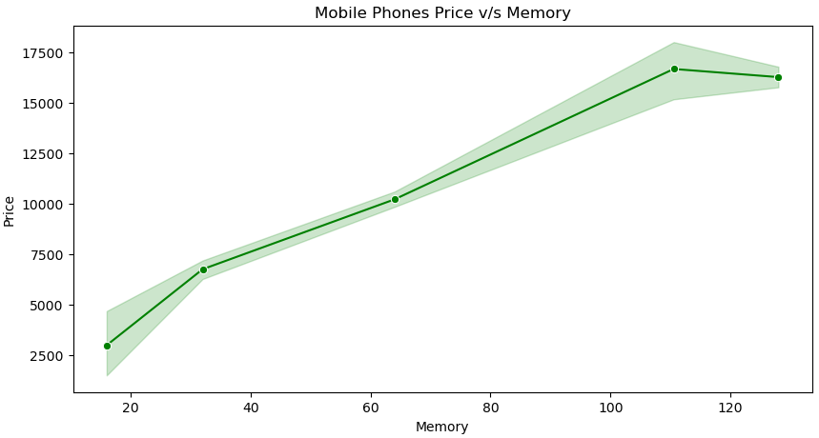
Mobile phone price v/s memory
The graph shows the change in price as the memory increases gives the following insights:-
1. The graph clearly shows that lesser the Memory lesser the Price and Higher the Memory Higher the Price.
2. We can see that Mobile Phones with Lowest Memory of 16GB has the lowest Price.
3. Also the Mobile Phones with Highest Memory of 128GB has the Higher Price.

Slide 7
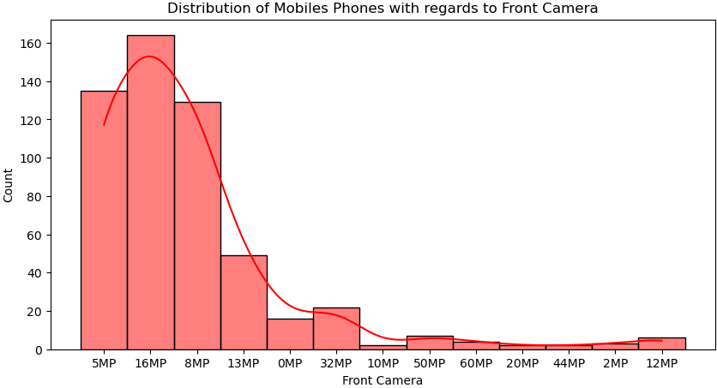
Distribution of Mobiles Phones with regards to Front Camera
We can see it's a positively skewed graph the tail of dataset lies on the right hand side.
2. Majority of the phones have Front Camera between 5MP to 8MP.
3. We have the high number of Mobile Phones having Front Camera of 16MP.
4. The Mobile Phones having Front Camera of 10MP, 44MP, 2MP, 20MP, 60MP, 12MP are lowest in numbers.

Slide 8
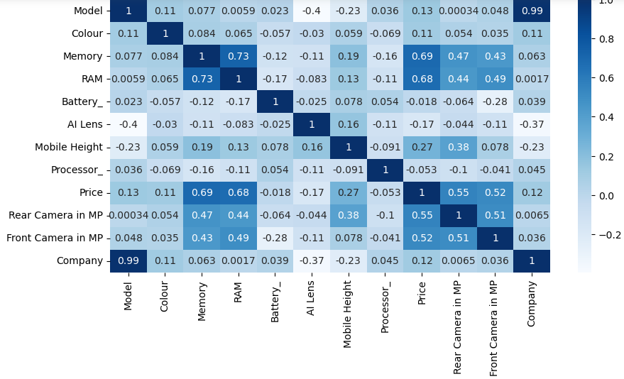
Correlation among all features
Insights from correlation matrix :-
Strong Positive Correlations:
Model and Company (0.99): These two variables are strongly positively correlated.
2. RAM and Memory (0.73): The RAM and Memory are strongly positively correlated to each other. This means that as the RAM increases Memory will also increase.
Moderate Correlations:
1.Price and Memory (0.69): There is a moderate positive correlation between price and memory , indicating that higher Memory may have higher price, but this isn't a perfect relationship.
2.Price and RAM (0.68): There is a moderate positive correlation between the Price and RAM indicating that phones having more RAM has higher price.
3.Rear Camera MP and Price(0.55): There is a moderate positive correlation between price and memory, indicating that more the Megapixel Camera higher the price.
Negative Correlations:
1.Mobile height and Company (-0.23): There is a slight negative correlation between the mobile height and the company, suggesting that mobile height is not related to the company.
2.Memory and Processor (-0.16): Memory has a moderately negative correlation with Processor, meaning that phones with better processor might have less memory.

Slide 9
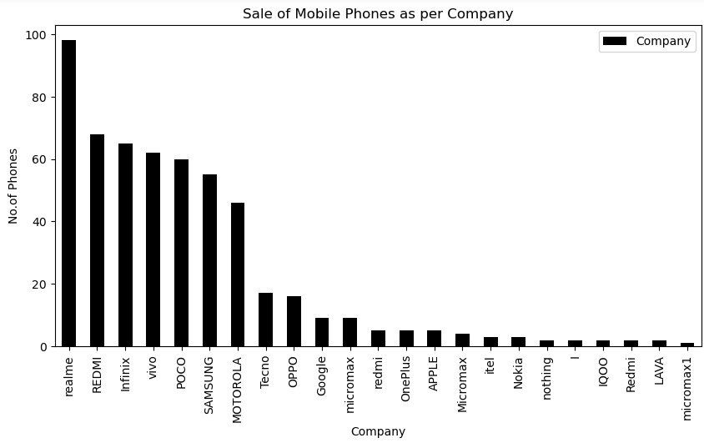
Sale Of Mobile Phones as per Company
As per the graph we can see the Highest Phones are sold of "Realme" i.e. 98.
2. "Micromax1" has the lowest sale rate. Only 1 unit of "micromax1" is sold.
3. After "Realme" we have :-
"REDMI" 68 "Infinix" 65 "vivo" 62 "POCO" 60 "SAMSUNG" 55 "MOTOROLA" 46 Having highest Sales.

Slide 10
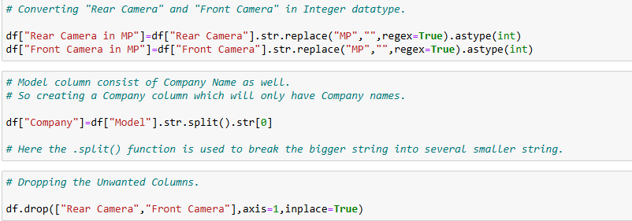

Feature Extraction and Feature Engineering.

Slide 11
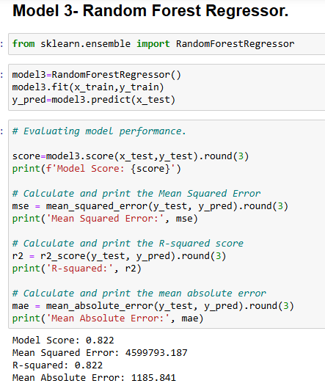
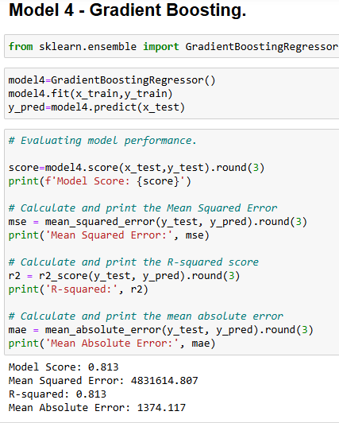
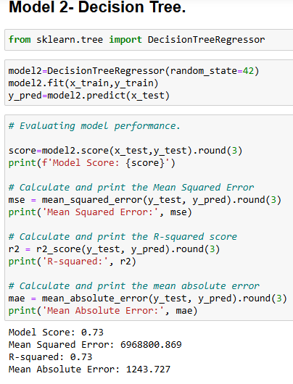
Model Building.

Slide 12
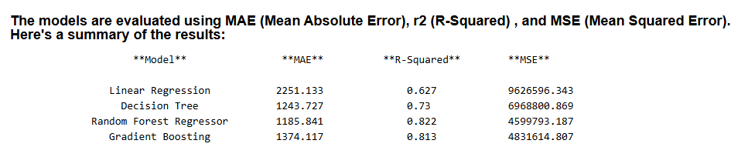
Model Comparison

Slide 13
Model Comparison Insights
1. Random Forest - The Top Performer
MAE: 2251.133 R-Squared: 0.822 MSE: 4599793.187
Insight:
Random Forest stands out as the best model based on MAE, R-squared, and MSE. It minimizes errors effectively, showing good generalization and stability.
The low MSE indicates minimal prediction variance, and the low MAE suggests that the model makes predictions that are close to the actual values on average.
2. Gradient Boosting - Close, But Slightly Less Precise
MAE: 1374.117 R-Squared: 0.813 MSE: 4831614.807
Insight:
Gradient Boosting almost matches Random Forest in R-Squared, but its MSE is slightly higher.
This indicates that while Gradient Boosting is effective for making predictions, it doesn't capture the data's complexity as well as Random Forest, leading to larger prediction errors in squared terms (MSE).
3. Linear Regression and Decision Tree - Moderate Performance
Linear Regression:
MAE: 2251.133 R-Squared: 0.627 MSE: 9626596.343
Decision Tree:
MAE: 1243.727 R-Squared: 0.73 MSE: 6968800.869
Insight:
Both Linear Regression and Decision Tree models show higher MSE and lower R-Squared than **Random Forest, indicating larger prediction errors.
MSE values are high between these two models, but they have less R-Squared (Random Forest and Linear Regression), suggesting that they are less effective in minimizing prediction errors.

Slide 14
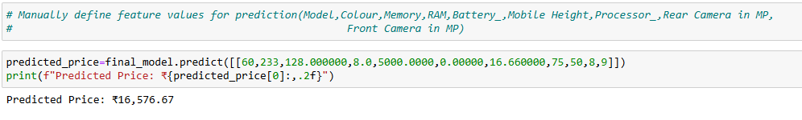
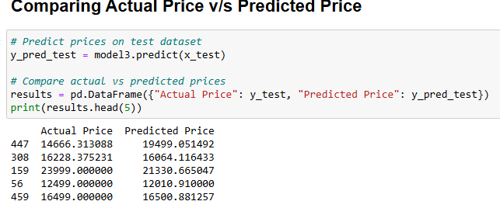
Mobile Price Prediction Model and Comparing Actual v/s Predicted

Slide 15
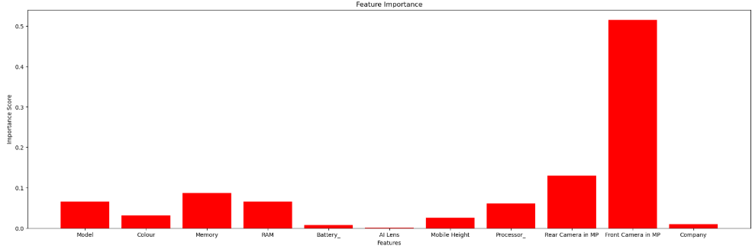
Feature Importance
The graph gives the following insights about feature importance :-
Feature Importance tells that which feature contributes the most in the prediction of target variable.
2. By the above graph we can see that "Front Camera in MP" plays a major role in the prediction of Mobile Phones Price.
3. It is not considering "AI Lens" as an important feature.
4. At the least it is considering "Battery".

Slide 16
THANK YOU

